Slide 1
Challenging students in designing software for special user groups
Nevena Ackovska
Magdalena Kostoska
Ana Madevska Bogdanova

Slide 2
Overview
HCI course at FCSE – Basics
Teaching methodology
Raising awareness
Students respond!
Conclusions

Slide 3
Human Computer Interaction course at FCSE
6 years - over 500 students
Basics of the complex interaction between the computer and the user
Tends to raise the awareness amongst the students that many users have different application usage skills, knowledge and opportunities

Slide 4
Course organization
This HCI course is elective course
offered to the students in their third or fourth year of Computer Science studies
Delivery:
Theoretical lectures with 2 classes per week;
Lecture exercises with 1 class per week; and
Practical lab tutorials with 2 classes per week

Slide 5
Topics
Humans in HCI
Computers in HCI
Design Principles for Usable Interfaces
The Development Process - Requirements Specification, Design and Development, Testing and Evaluation
Designing for Diversity
Design for Users with Special Needs
Interaction Principles for Special Applications
Embedding Technologies in HCI
Application/Domain Specific Design

Slide 6
Grading
# | Activity | Points | Min. points to pass
1 2 3 | Laboratory exercises Theory (Midterms or Final) Project and related homework | 30 40 30-50 | 15 20 15-25

Slide 7
Methodology (1)
Theory
Classical teaching classes
Great addition - Invited lecturers
people involved in practical HCI design: digital artists that have created successful GUIs, software developers, hardware creators and other company representatives
There is a change in the perception and it challenges the students to think “outside the frame”
This makes the course enriched with components, which are rarely thought in Computer science curricula.

Slide 8
Methodology (2)
Projects
At the beginning of the semester the students propose a challenging project they are interested to produce
the proposal is in form of scenarios and high-level goals
Team creation is encouraged, but individual work is allowed as well
For the rest of the semester students actively work on their project and have milestones they should achieve,

Slide 9
Project development

Slide 10
Raising awareness
HCI at FCSE introduces knowledge about different kinds of target groups
Software and hardware products for these clients come with special limitations
the students are thought recommendations how to build applications, working under strict constraints
This is challenging!

Slide 11
How to do it?
Touch something close to heart
Family members
Friendship
Love
Hobby, Work
Pets

Slide 12
Target groups are interesting for students!
Applications for users with great limitations:
people with limited motoric functions
blind or people with limited sight,
deaf and hard of hearing etc.
Also larger groups with specifics:
kids
elderly people
Social groups – music, sports, travel, pets…
which require specific and limiting interface design as well
…..

Slide 13
Title | Target group | Raising awareness about
Sign Language Tutor | Deaf and hard of hearing kids, also parents, siblings and friends of the deaf or hard of hearing kids | The world of deaf and hard of hearing people and Macedonian Sign Language
HCI Voice App 1.0 | Users with motoric constraints that cannot use mouse or keyboard | Limitation of the input data process and alternative solutions, in this case voice recognition
Studiamo Italiano (Let’s learn Italian) | Users with reduced locomotor capabilities (limited motoric movements) interested in learning foreign languages | Limitation of the input data process and alternative solutions, in this case special hardware assistant
Fitness guide | Users with vision deficiencies like color blindness and myopia | Limitations of the colors and font size used
Health Counsellor | Older adults | Limitations in this population, such as demands for spatial memory, working memory, visual functions and motor skills
My cook book | Older adults
News aggregator | Older adults
Let’s learn number and letters | Kids (age 4 to 7) | Limitations like brief attention spans, difficulty with abstractions, preliterate (avoidance of keyboard use), limited motoric precision
Learning fruits, vegetables and animals | Kids (age 4 to 7)
Nature and society introduction | Kids (age 7 to 9) | Appreciate playful approach, simple keyboard use

Slide 14
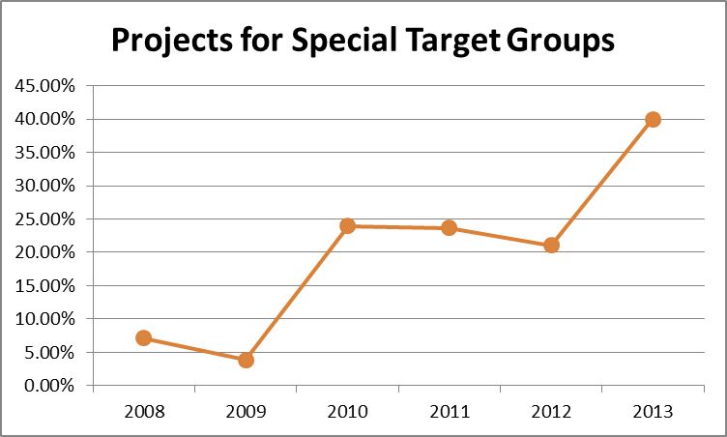

Slide 15
Technology changes
People are different, unpredictable, self – specific….!
But this is fixed and it won’t change!
But applications change
With technology changes or the new needs of the users
So, our students need to learn more

Slide 16
Sign Language Tutor
Interactive platform for Macedonian Sign Language (MSL) learning
It represents a collection of games and modules that will ease the learning and increase the mental and memory skills of the deaf and hard of hearing kids
The central part of this project consists of 3D animations of a girl that signs the chosen alphabet character or objects
Two additional games: memory game and explore game

Slide 17
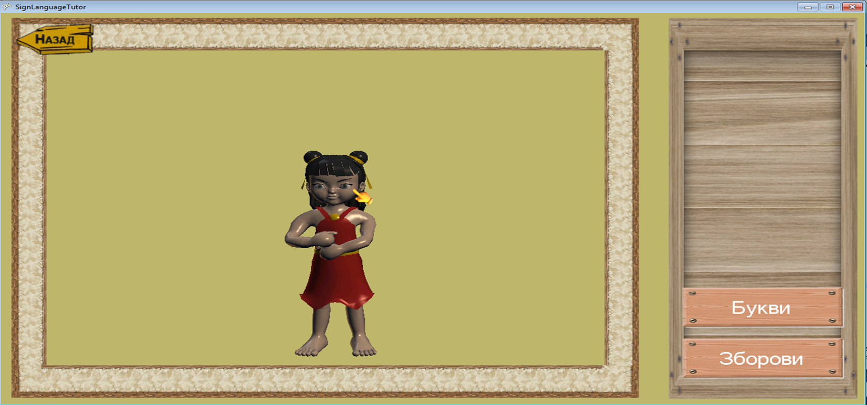
Sign Language Tutor
Learn XNA technology
Use mathematical knowledge about vectors, matrices and their transformation to create custom animation importer and games

Slide 18
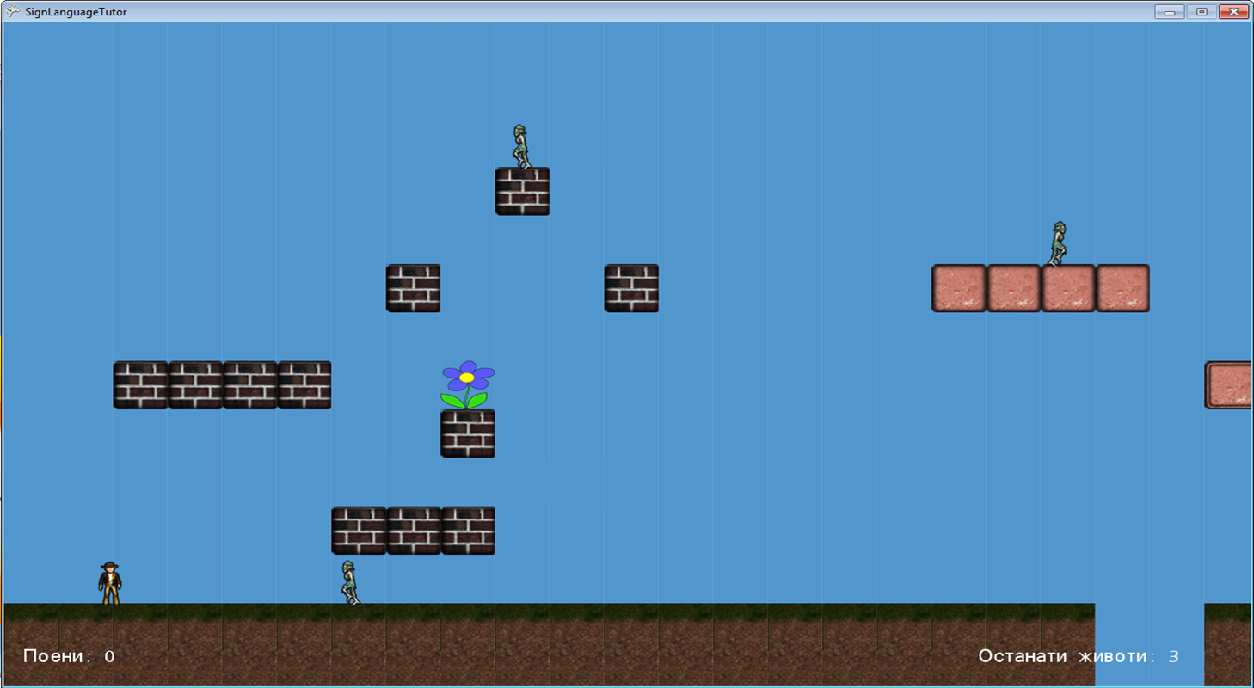
Sign Language Tutor

Slide 19
Virtual World
Multiplayer online game
Idea: learning Geography (Europe) through game and fun
Users can explore, read informations, communicate with other users in the same state (map) and move between states (maps)
The student had to learn ActionScript (Adobe Flash) to create the interaction in the game and isometric projection for maps creation, and uses A* algorithm

Slide 20
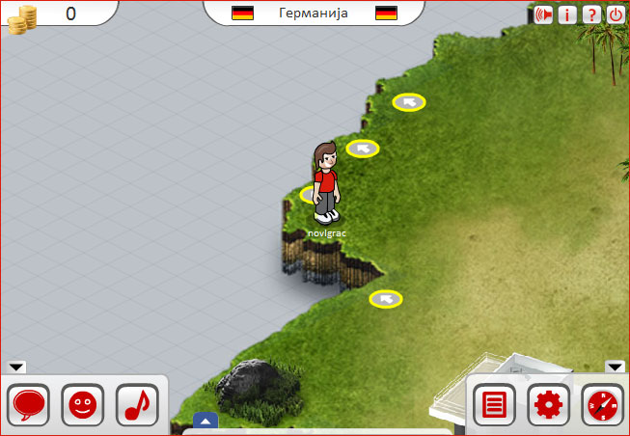
Virtual World

Slide 21
WordWell
iPhone game
Main objective: to create a word using the given letters
Goal: to improve user’s vocabulary
The student had to learn Objective C and iOS SDK technology and to use probability and randomness algorithms in order to create good algorithms for letter selection and score calculation

Slide 22
Results
one of the goals of this course is the students to create final project following specific HCI guidelines
They DO!
200 such projects in the past 6 years

Slide 23
They learn more!
Some of the researches that students conducted were intense - gather knowledge that borders medicine, ergonomics, social sciences and psychology…
Even more so, the students needed to revive the knowledge in mathematics, optimization techniques, algorithms etc.
The students are interested to learn more, about the specific target group as well as about the technologies that enabled better application development

Slide 24
Afterwork - students continue
33 of these projects were evolved to a diploma thesis
fully functional applications for a specific target group or for specific application domain
Those projects are offered to the specific users, and used in their everyday activities
Many of these projects were intended to help not only the specific users, but also the people of their most imminent environment
Sign Language Tutor
MsC - Human Robot Interaction or similar

Slide 25
Conclusion
Stimulate student
to try new technologies and to apply knowledge gained in other, previously taken, courses
Students research
and are constantly encouraged to ask questions, to find answers and to improve their projects
Raise awareness
of the students about the people with disabilities, age-aware design, even with different culture values

Slide 26
Conclusion
The most persistent course participants decided to create their graduate work in this area
This shows that this course encourages the students’ natural curiosity and motives them to investigate further in order to create better IT tools for a specific user.

Slide 27
Thank you!
Questions please ☺

